Slide 1
Language for Enterprise Modelling
(important)

Slide 2
Language for Enterprise Modelling
Target of this Chapter:
  Undertand purpose of using Enterprise Modelling language
  Undertand enterprise architecture model

Slide 3
Language for Enterprise Modelling
1.Describing Coherence
2.Service Orientation and Layering
3.Three Dimensions of Modelling
4.Business Layer Concepts
5.Application Layer Concepts
6.Technology Layer Concepts

Slide 4
1.Describing Coherence
It provides a means for integration
show high-level structures within domains and the relations between domains
it provides the basis for the visualisation and analysis techniques

Slide 5
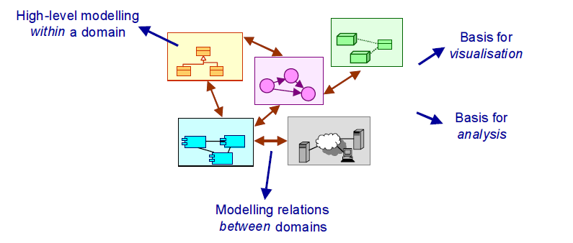
1.Describing Coherence

Slide 6
2.Service Orientation and Layering
In the enterprise modelling language that we propose, the service concept plays a central role.
A service is defined as a unit of functionality
they can be provided by organisations to their customers, by applications to business processes, or by technological facilities (e.g., communication networks) to applications.

Slide 7
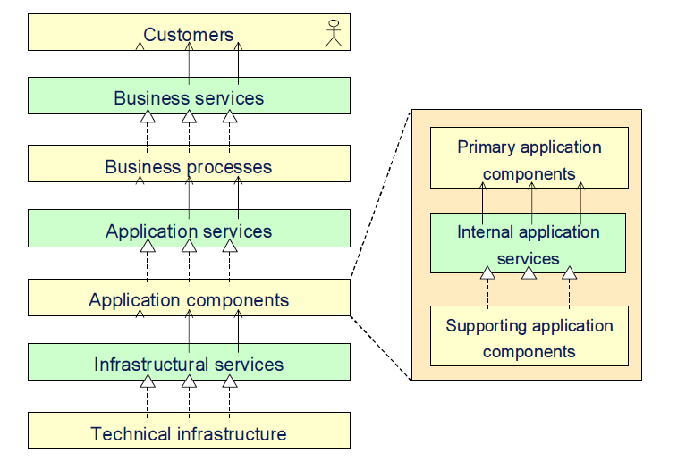
2.Service Orientation and Layering

Slide 8
2.Service Orientation and Layering
Service layers with services made available to higher layers are interleaved with implementation layers that realise the services. we distinguish three main layers:
        business layer
        application layer
        technology layer

Slide 9
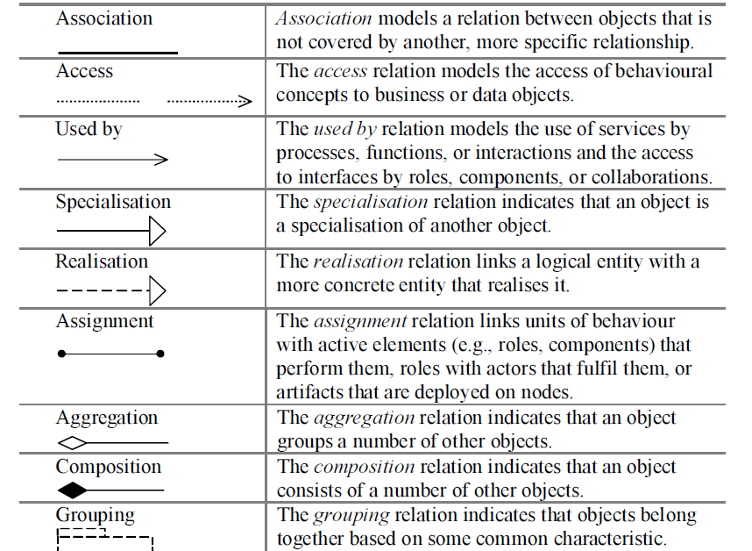
3.Three Dimensions of Modelling

Slide 10
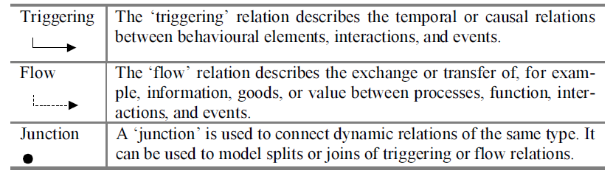
3.Three Dimensions of Modelling

Slide 11
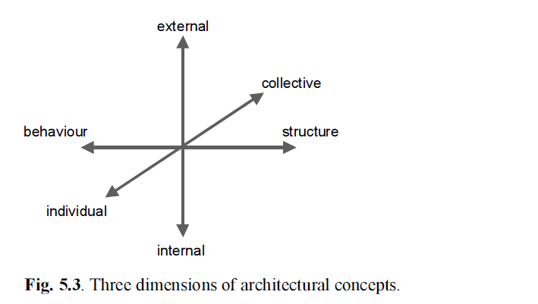
3.Three Dimensions of Modelling

Slide 12
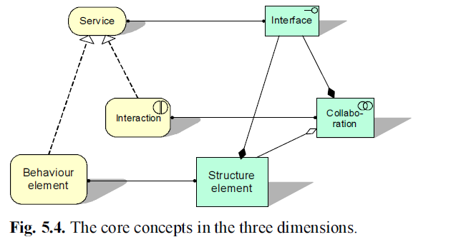
3.Three Dimensions of Modelling

Slide 13
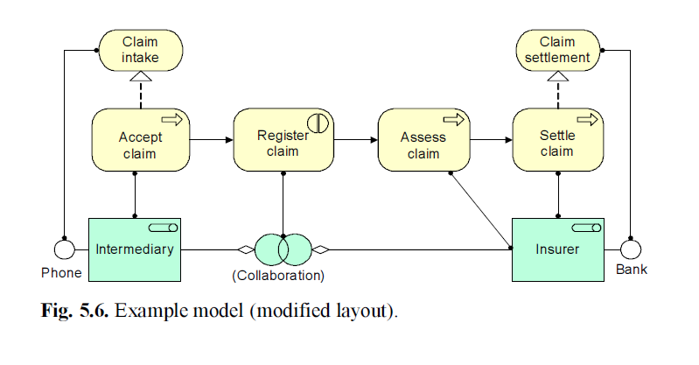
3.Three Dimensions of Modelling

Slide 14
3.Three Dimensions of Modelling
we distinguish:
  the structural or static aspect and the behavioural or dynamic aspect
  active structural elements and passive structural elements
  information objects and data object

Slide 15
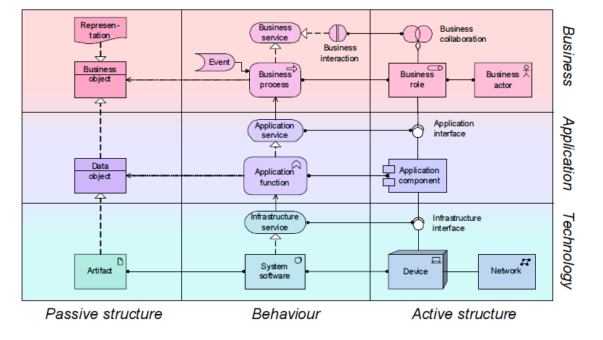
3.Three Dimensions of Modelling

Slide 16
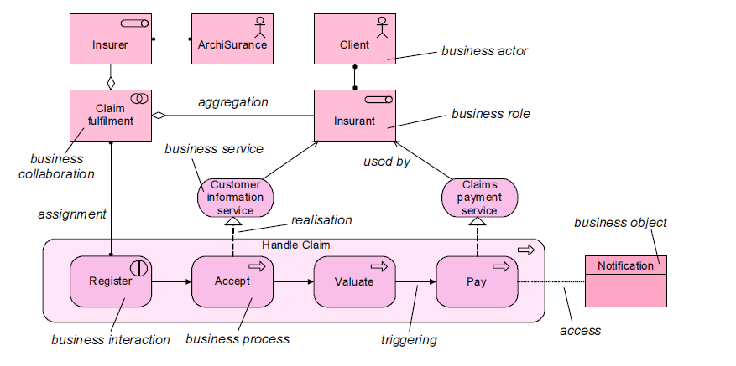
4.Business Layer Concepts

Slide 17
4.Business Layer Concepts
Business Structure Concepts: The central structural concept is the business actor.
  Business actor: an active entity that performs behaviour (i.e., the ‘subject’ of behaviour).
  Business role: states which business behaviour is performed by a business actor that fulfils this role.
  Business collaboration: a (possibly temporary) collective of roles within an organisation which perform collaborative behaviour (interactions).

Slide 18
4.Business Layer Concepts
  Business interfaces: the (logical or physical) locations where the services that a role offers to the environment can be accessed.
  Business objects: the passive entities such as business processes or functions that are manipulated by behaviour.
  Representation: the perceptible form of the information carried by a business object, such as a document.

Slide 19
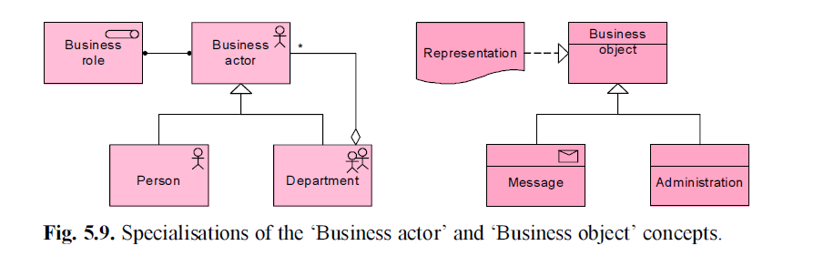
4.Business Layer Concepts

Slide 20
4.Business Layer Concepts
Business Behaviour Concepts:Business services are used to expose business functionality to the environment.
  Business service: a coherent piece of functionality that offers added value to the environment, independent of the way this functionality is realised internally.

Slide 21
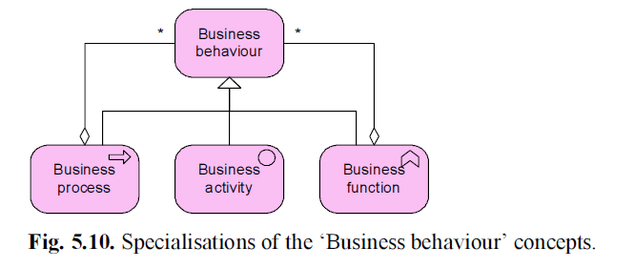
4.Business Layer Concepts

Slide 22
4.Business Layer Concepts
  Business activity: the smallest level of decomposition of business
  Business process: a ‘flow’ of activities, with one or more clear starting points and leading to a clearly defined result.
  Business function: offers functionality that may be useful for one or more business processes.

Slide 23
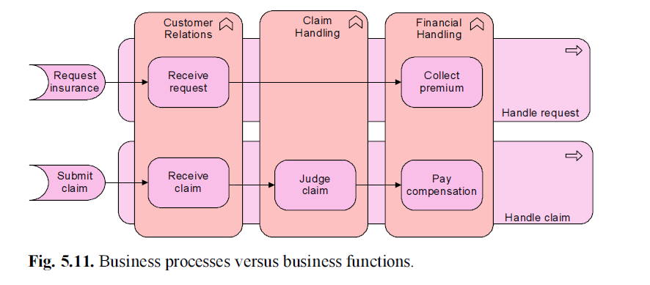
4.Business Layer Concepts

Slide 24
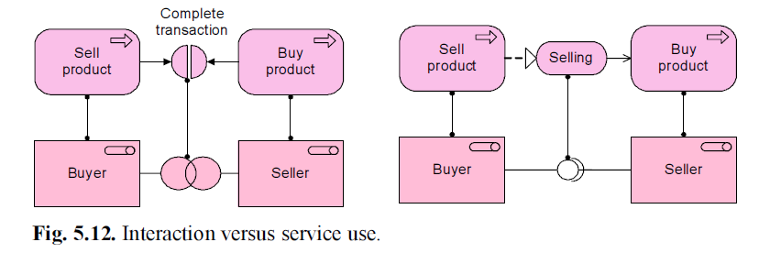
4.Business Layer Concepts
  Business interaction: behaviour performed in a collaboration of two or more business roles.

Slide 25
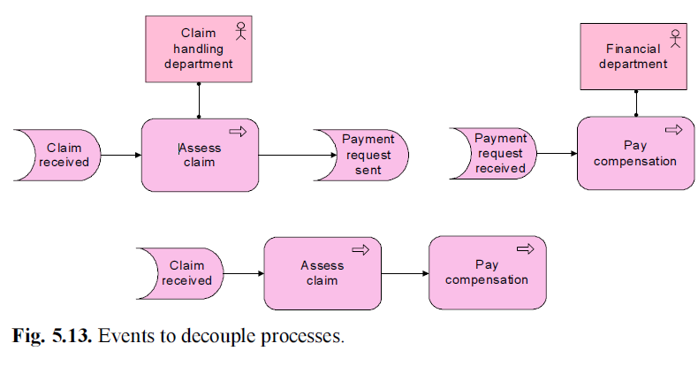
4.Business Layer Concepts
  Business event: something that happens (externally) and may influence business processes, functions, or interactions.

Slide 26
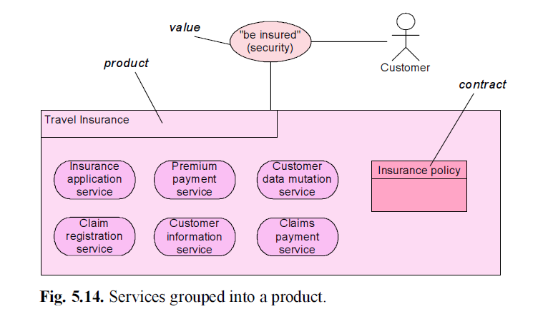
4.Business Layer Concepts
Product: a collection of services together with a contract that specifies the characteristics, rights, and requirements for their use.

Slide 27
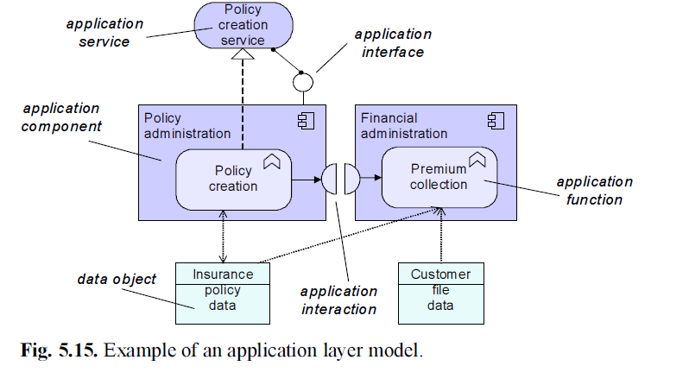
5.Application Layer Concepts
Application Structure Concepts:

Slide 28
5.Application Layer Concepts
  Application component: self-contained part of a system that encapsulates its contents and exposes its functionality through a set of interfaces.
  Application collaboration: a collective of application components,which perform application interactions.
  Application interface: defines the set of operations and events that are provided by the component, or those that are required from the environment.
  Data object: a coherent, self-contained piece of information suitable for automated processing.

Slide 29
5.Application Layer Concepts
Application Behaviour Concepts:
  Application service: an externally visible unit of functionality, provided by one or more components, exposed through well-defined interfaces,and meaningful to the environment.
  Application function: the internal behaviour of a component needed to realise one or more application services.
  Application interaction: the behaviour of a collaboration of two or
  more application components.

Slide 30
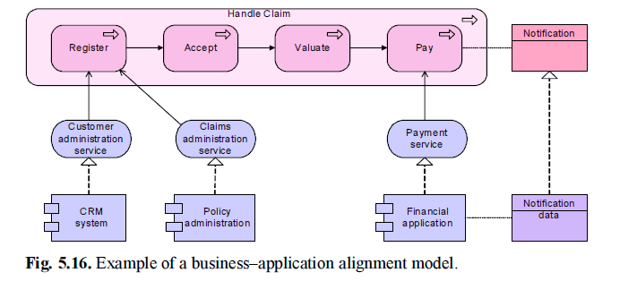
5.Application Layer Concepts
Business–Application Alignment:

Slide 31
5.Application Layer Concepts
Application services can be used by business behaviour and application interfaces are used by business actors roles, i.e., there is a support relation between the application and business layers.
Data objects can realise business objects; this means that a data object is an electronic representation of the business object, i.e., there is an implementation relation between the application and business layers.

Slide 32
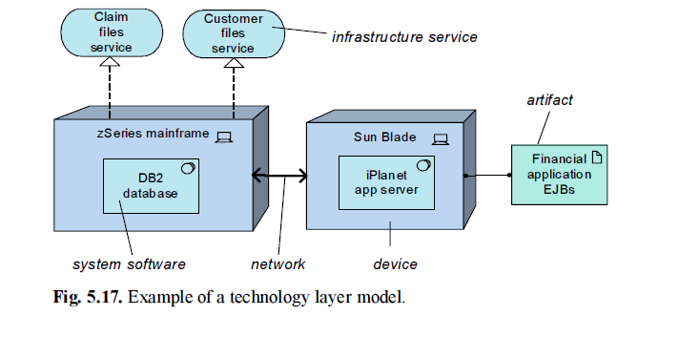
6.Technology Layer Concepts

Slide 33
6.Technology Layer Concepts
Technology Structure Concepts:
  Node: represents a structural entity in the technology layer.
  Infrastructure interface: the (logical) location where the infrastructural services offered by a node can be accessed by other nodes or by application components from the application layer.
  Artifact: a physical piece of information that is used or produced in a software development process, or by deployment and operation of a system.

Slide 34
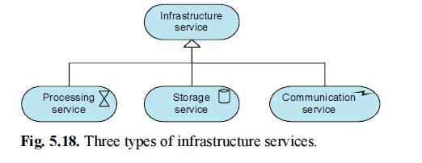
6.Technology Layer Concepts
Technology Behaviour Concepts:The technology layer provides infrastructure services to be used by applications.
  Infrastructure service: externally visible unit of functionality, provided by one or more nodes, exposed through well-defined interfaces,and meaningful to the environment.

Slide 35
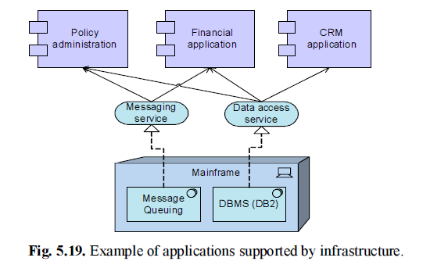
6.Application–Technology Alignment

Slide 36
6.Application–Technology Alignment
Infrastructure services can be used by application functions and infrastructure interfaces are used by application components, i.e., there is a support relation between the technology and application layers
Artifacts can realise data objects and application components, i.e., there is an implementation relation between the technology and application layers

Slide 37
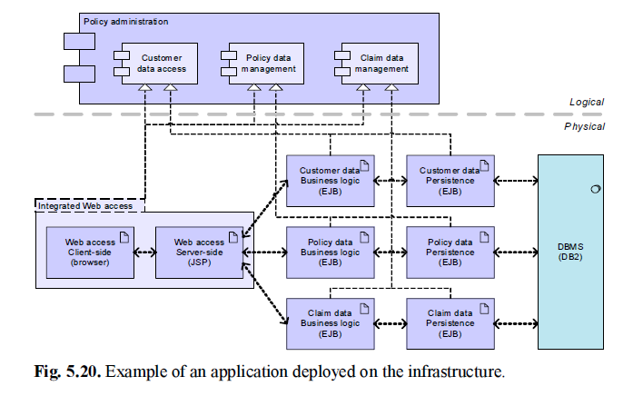
6.Application–Technology Alignment

Slide 38
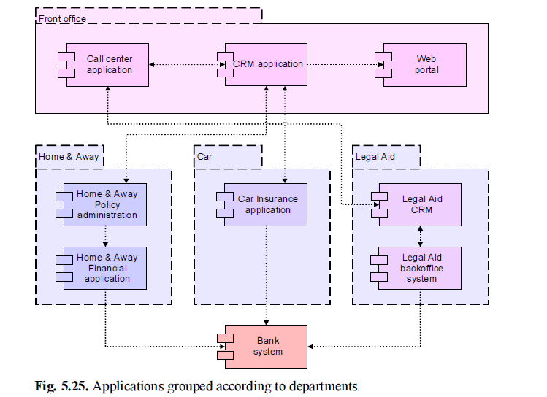
EXAMPLE
ArchiSurance example( page 109)

